Slide 1
Chemistry 3A
Introductory General Chemistry
Matter & Its Physical Properties, Compounds and Their Nomenclature, Criss-Cross Method, Polyatomic Ions, (Oxy)Acids and Naming
S. M. Halloran

Slide 2
This Slide Set: Book Chapter 4
Matter: Properties and Changes Affecting It
Compounds
Molecules As Polyatomic Forms of The Elements
Ionic Compounds
Chemistry Nomenclature: Naming of Compounds

Slide 3
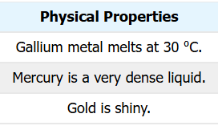
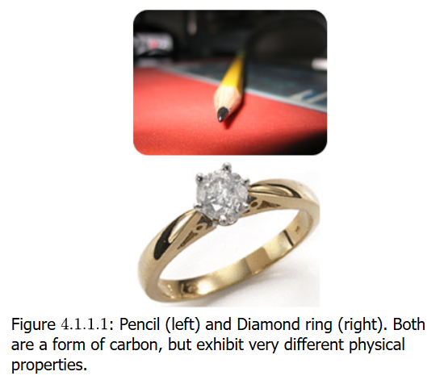
Matter: Properties and Changes Affecting It
Physical Property
a characteristic of a substance that can be observed or measured without changing the identity of the substance
Color | Electrical conductivity
Hardness | Density
Malleability (ability to be hammered) | Melting point
Solubility | Boiling point
The “lead” in the pencil and
the diamond are both PURELY forms of
the element carbon,
but physically they are VERY different

Slide 4
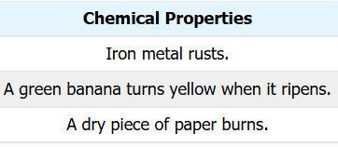
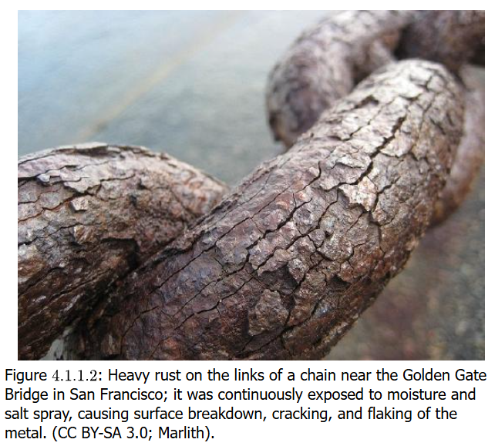
Matter: Properties and Changes Affecting It
Chemical Property
potential to undergo some
chemical change or reaction
by virtue of its composition
Metals like Zn (zinc) reacting with acid
Forming oxides in reacting
with oxygen This involves
substances changing into
other substances
When first looking at the image on the right, I thought it was the bark on a plant with interesting stem geometry, but when told it was some kind of corrosion on links of a metal chain, it required a double-take

Slide 5
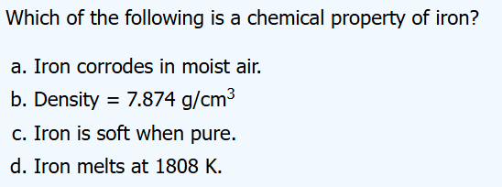

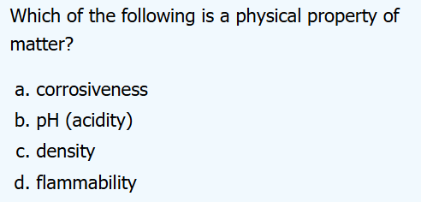

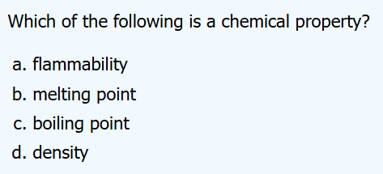

Matter: What is a Physical/Chemical Property?

Slide 6
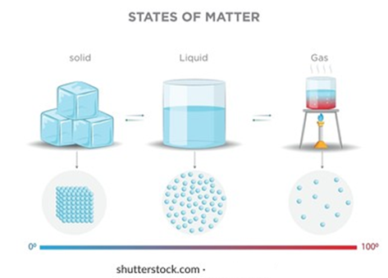
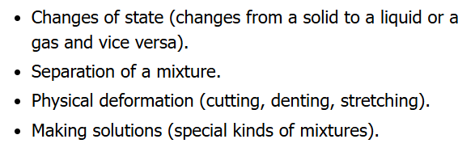
Physical (State) Changes
States of matter are solid, liquid, gas
Changes in the states of matters are:
Vaporization
  Liquid to gas
Freezing
  Liquid to solid
Condensation
  Gas to liquid
Descriptions where
there is a kind of
physical (not chemical)
change to matter

Slide 7
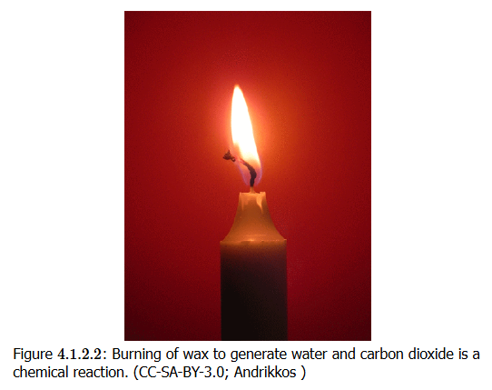
Chemical Changes
This involves a change to the compounds—combination of atoms of elements through bonding—that make up matter
In the burning of wax in a candle, atmospheric oxygen gas reacts with the complex of carbon compounds to form carbon dioxide and water (the products being in gaseous form)
Indicators of chemical change
temperature changes
appearance of light/flash
(unexpected) color change
gas bubble formation not related
to boiling (a physical change)
change in a smell/taste
formation of solid in a liquid:
precipitation

Slide 8


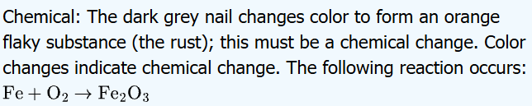


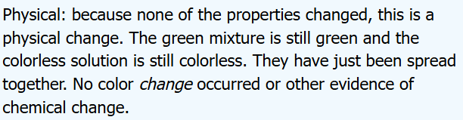


Change: Physical or Chemical?

Slide 9
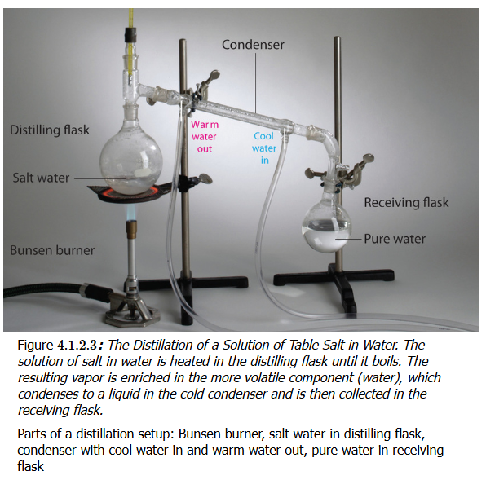
Making Use of Physical Properties
Distillation
Separating/purifying
compounds based on
boiling point
Precipitation
Separating/purifying
compounds based on
solubility
  Some stay in solution,
  Others come out of solution

Slide 10
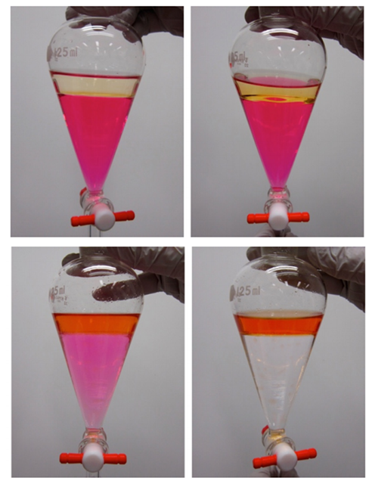
Making Use of Physical Properties
Solvent Extraction
Separating/purifying
compounds based on preference
(“partition”) for organic vs
aqueous solvents
Chromatography
Separating/purifying
compounds based on same
principle as solvent extraction
but with flowing (mobile) vs
non-flowing (stationary) phases

Slide 11
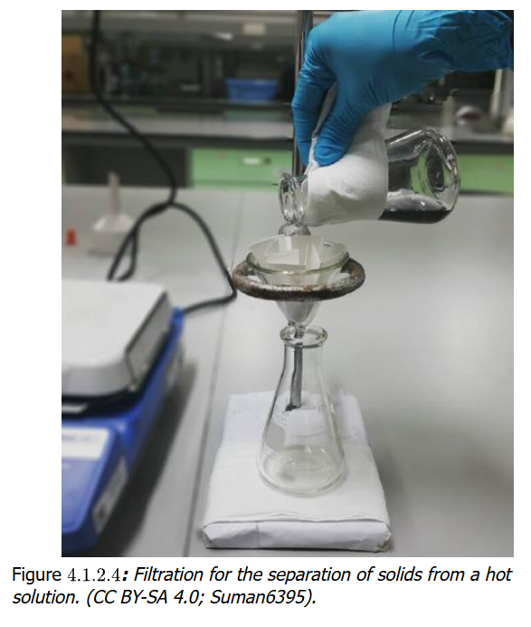
Making Use of Physical Properties
Filtration
In its many forms,
filtration achieves the
separation of matter in
one phase from another
While it is usually
separating liquids from
solids, it can include
separating gases from
liquids as well.

Slide 12
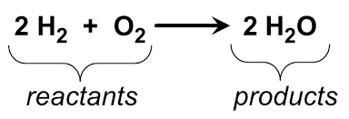
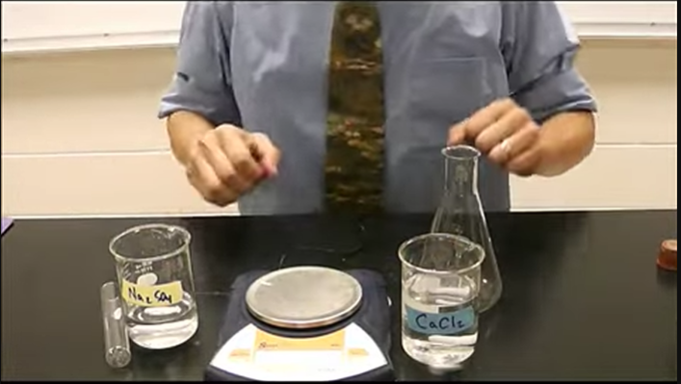
LAW of Conservation of Mass
1789 French chemist Lavoisier
Matter cannot be created or destroyed
Chemical reaction: mass of reactants and mass of products identical
https://www.youtube.com/watch?v=Wwmsy4huZQ0

Slide 13
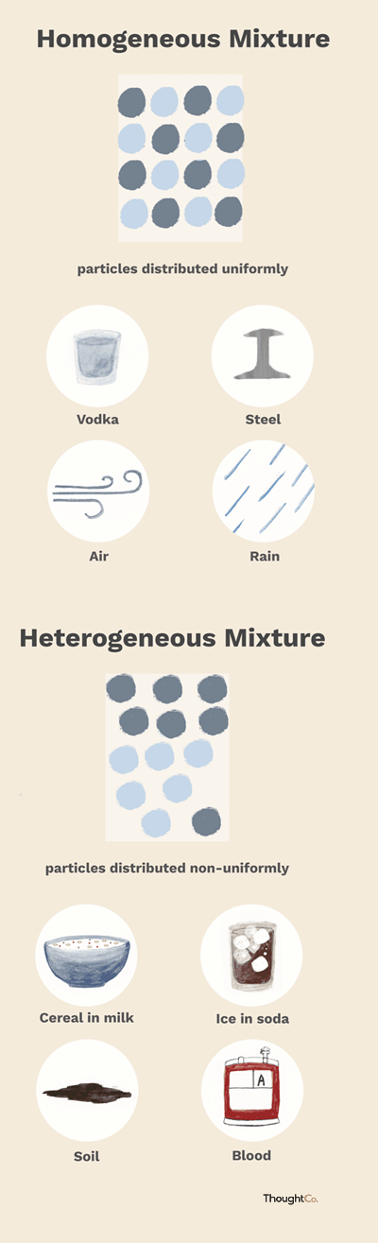
Mixtures
Multiple phases may be present
Components are not evenly distributed
You can often see or separate the parts
Homogeneous
one in which the composition is uniform throughout. You can’t see the individual components, and every sample taken from the mixture will have the same properties
Appears as a single phase (solid, liquid, or gas)
Evenly distributed particles
Cannot distinguish components by eye
Heterogeneous
has a non-uniform composition
The different parts of the mixture are visibly distinct, and samples taken from different areas may have different properties
Multiple phases may be present
Components are not evenly distributed
You can often see or separate the parts

Slide 14
Compounds
A compound is a substance that contains two or more elements chemically combined in a fixed proportion
CH₄ (methane)
One carbon atom
Four hydrogen atoms
Unlike mixtures, cannot be separated by physical means
Can be “decomposed” by chemical changes
CH₄ (g) + 2 O₂ (g) → CO₂ (g) + 2 H₂O (g)

Slide 15
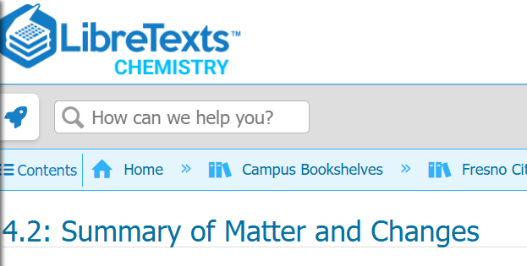
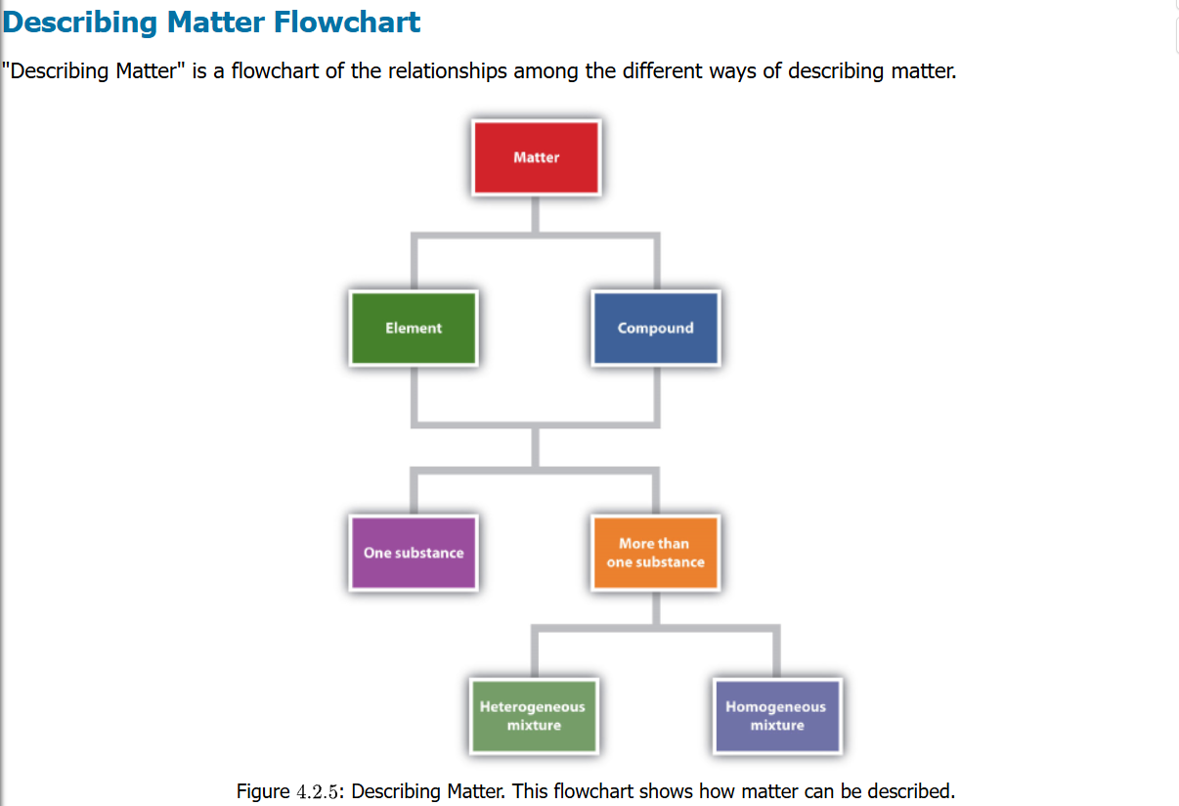
Summary

Slide 16
Compounds: Chemical Formula
A chemical formula is a way of presenting information about the relative chemical proportions of atoms that constitute a particular compound or molecule
H₂O – dihydrogen monoxide (water)
H₂SO₄ – sulfuric acid
Ca₃(PO₄)₂ – calcium phosphate
N₂O₄ – dinitrogen tetroxide
CuSO₄ • 5 H₂O – copper sulfate pentahydrate

Slide 17
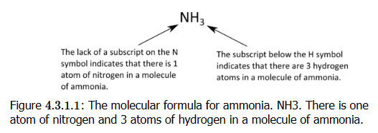
Compounds: Molecular Formula
A molecular formula is a chemical formula gives number of atoms of each of the elements present in one molecule of a specific compound
It is composed of element symbols for the atoms and subscripts to indicate count of the atoms. If there is only one atom in the compound, a subscripted “1” is omitted

Slide 18
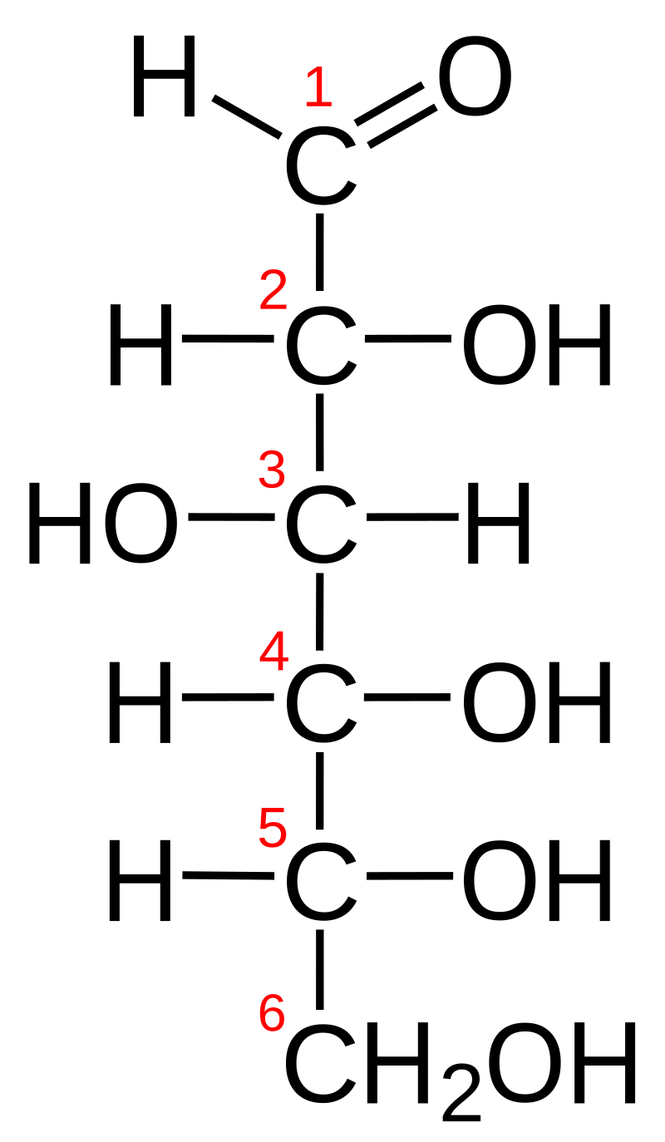
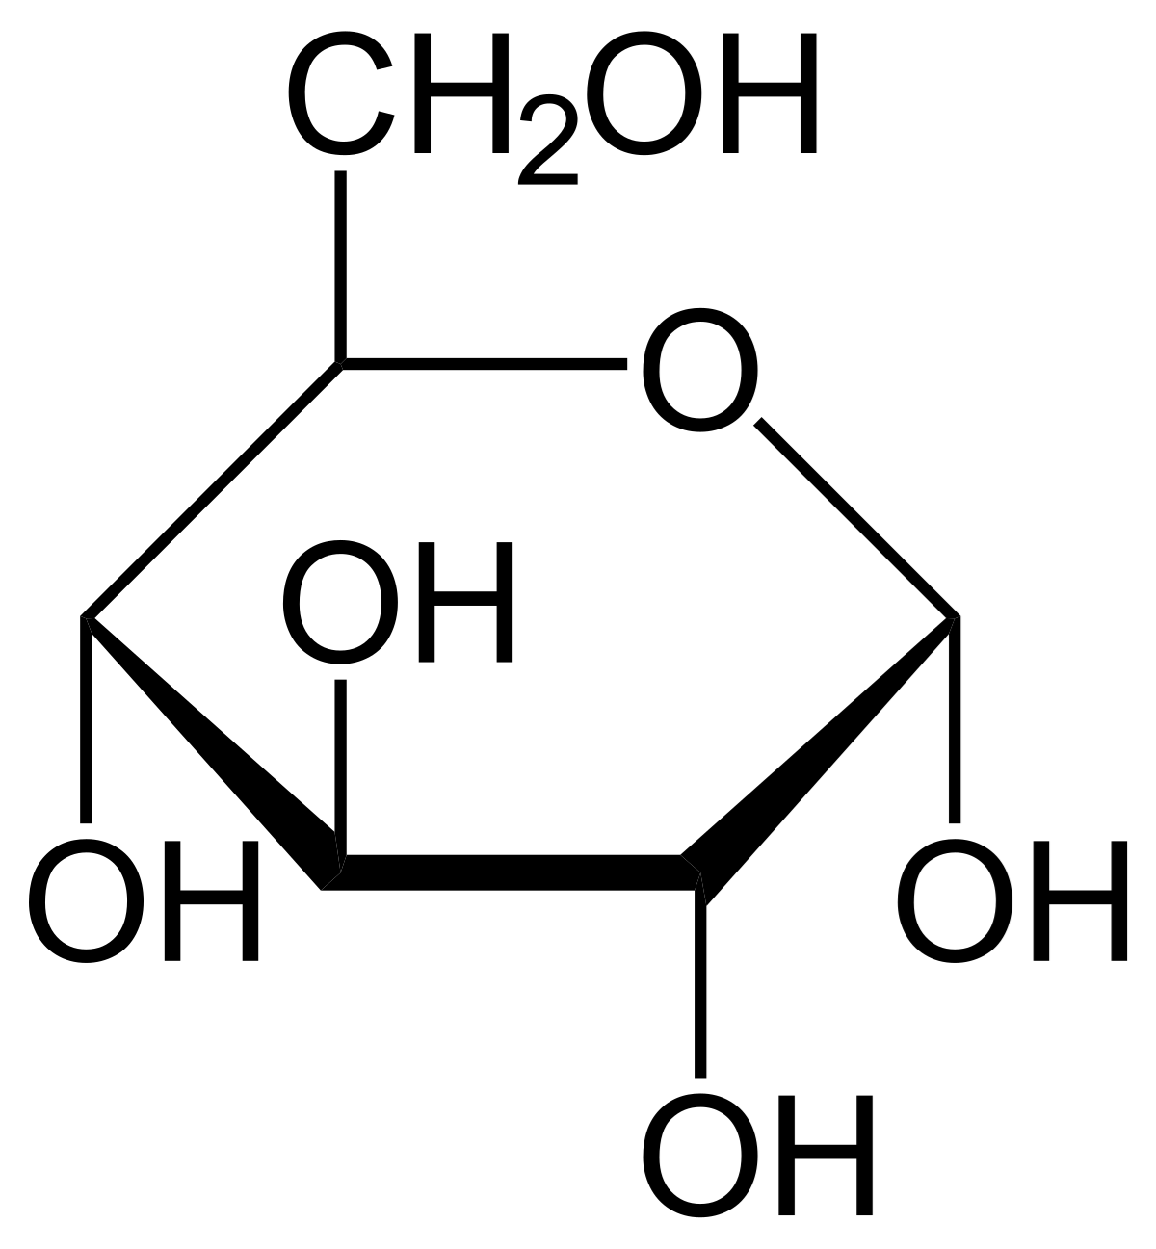
Compounds: Empirical Formula
An empirical formula is a chemical formula that shows the elements in a compound in their lowest whole-number ratio
Glucose has a
molecular formula
of C₆H₁₂O₆
But glucose has an
empirical formula
of CH₂O
Why? Because when chemists first start to analyze & characterize an unknown compound, they find glucose has 1 part carbon, 1 part oxygen, 2 parts hydrogen
NOTE THIS: in some cases the empirical formula and molecular formula are the same!!

Slide 19
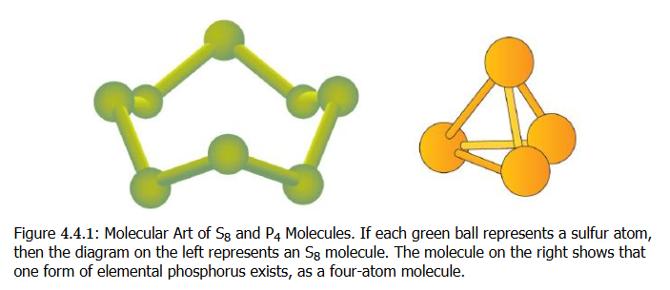
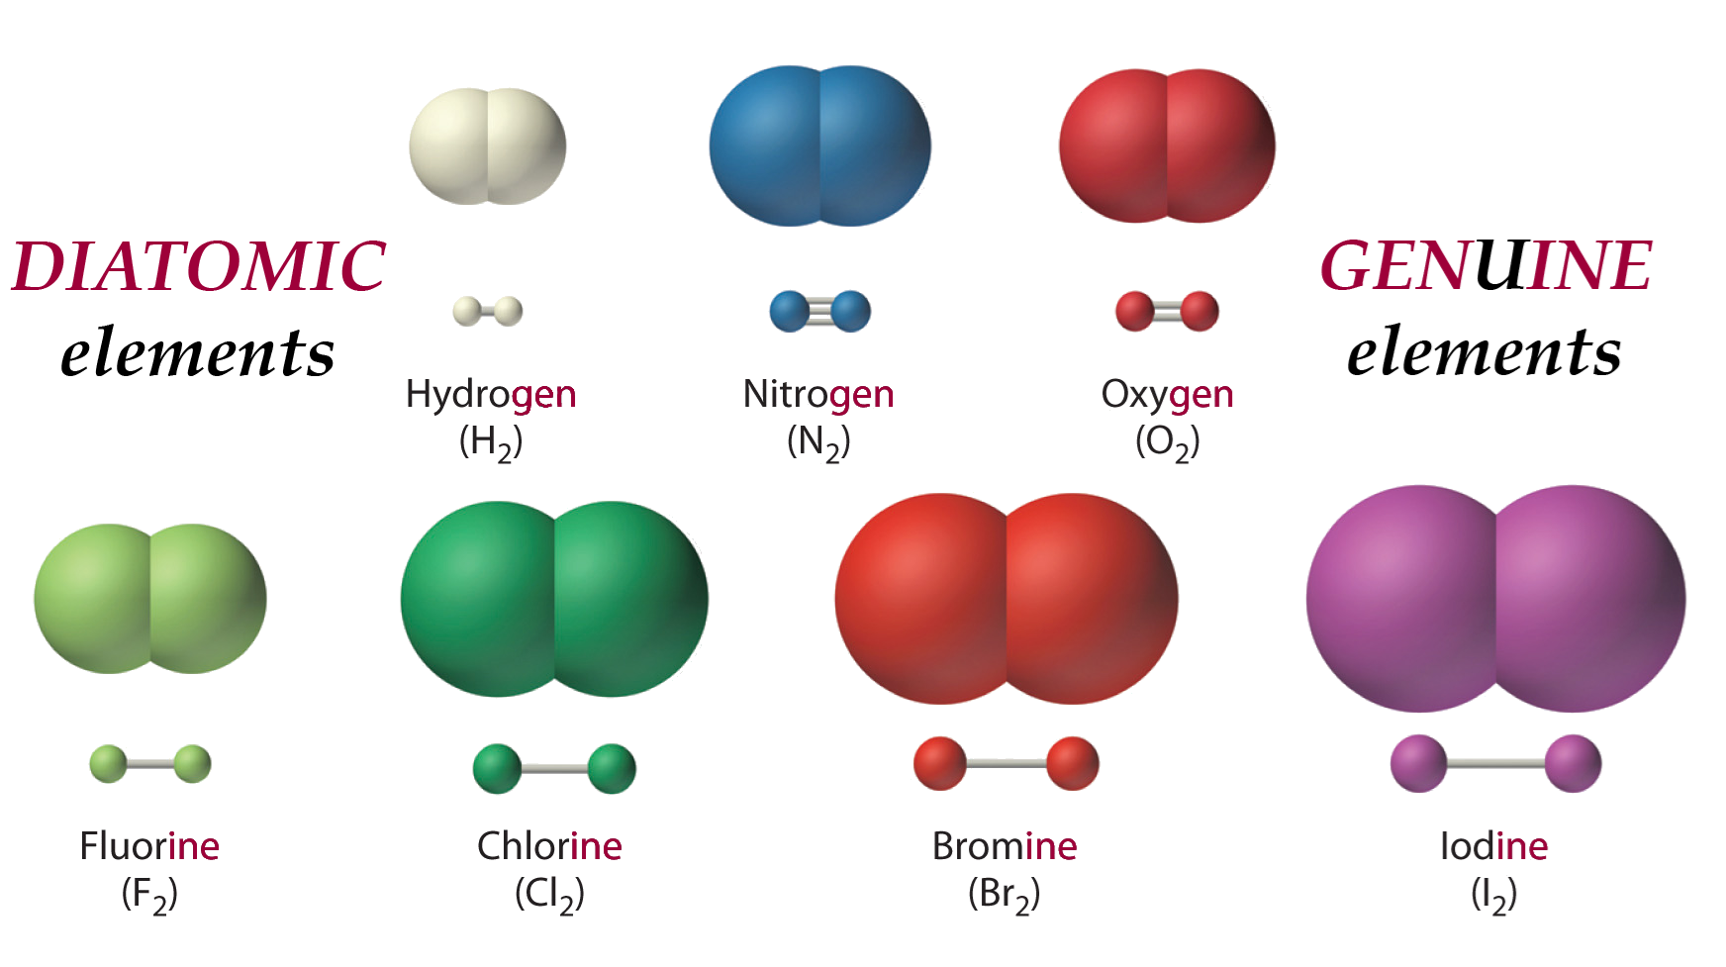
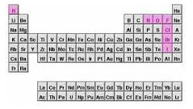
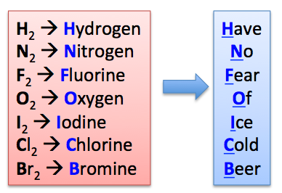
Atomic Elements, Molecular Elements
Elements that exist as their individual atoms in nature are called atomic elements
Some elements do not exist in nature as individual atoms, but bonded with each other. These are molecular elements
  Molecular elements can form often diatomic molecules or polyatomic molecules

Slide 20
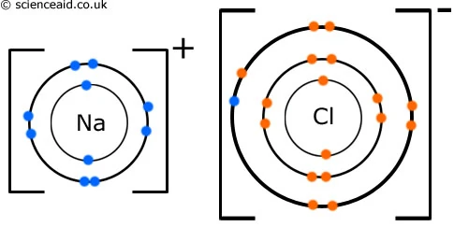
Ionic Compounds
Ionic compounds form when
atoms BOND with each other
based on one atom have
a positive charge and the
other having a negative charge
A sodium (Na) atom easily gives up the ONE electron (all for energetic stability) which is its ONE valence shell electron to a chlorine (Cl) atom which has SEVEN valence shell electrons and wants a more stable complete valence shell of EIGHT electrons. The electron transfer creates an IONIC bond and Na and Cl will form an ionic compound as a result

Slide 21
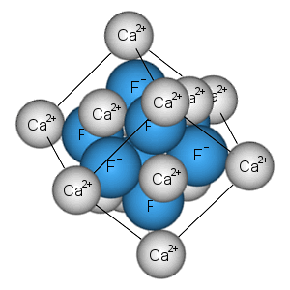
Ionic Compounds
Generally metal elements will
form ionic compounds with
nonmetal elements in the correct
ratios
Metals will give up electrons and
nonmetals as a rule to form these
ionic compounds
(with lots of exceptions to the rule)

Slide 22
Formula Unit
“The formula unit is the basic unit of ionic compounds”
Also: “in chemistry, a formula unit is the smallest unit of a non-molecular substance, such as an ionic compound, covalent network solid, or metal
Something that does form a discrete molecule, something not forming a molecular compound
NaCl, CaF₂, ZnBr₂ are the three formula units of these ionic compounds

Slide 23
Ionic Compounds
Ionic compounds will dissolve in water to form individual ions that move about
When they form crystal solids, they exist in a lattice with an ordered structure in the correct ratio of atoms of the formula unit in the solid state
The ratio of atoms in the formula unit should have a zero net charge
Aluminum nitride
aluminum ion has 3+ charge: Al³⁺
nitride ion has a 3- charge: N³⁻
One Al³⁺ combines with one N³⁻ → Al₁N₁
Final formula: AlN (leave out 1s if in subscript)

Slide 24
Ionic or Not Ionic?
Is the cation a metal and anion a nonmetal?
Ionic
Are all the atoms in the molecule/compound nonmetallic elements?
Not ionic if the compound has NO charge
Is there a polyatomic group that you recognize as ionic?
Well definitely ionic
  Ammonium (NH₄⁺) cation
  Nitrate (NO₃⁻) anion

Slide 25
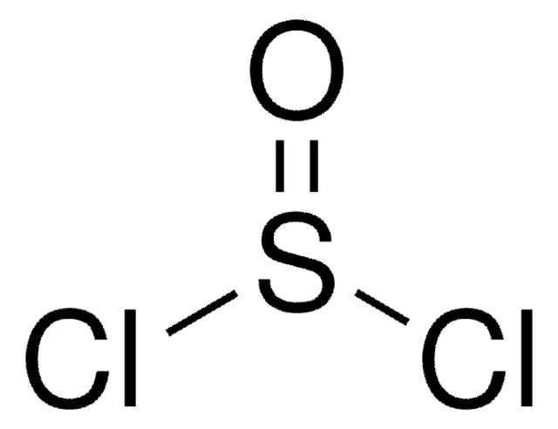
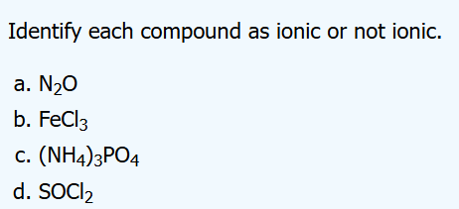
Ionic or Not Ionic?
A) nitrogen (N) and oxygen (O) atoms nonmetals:
not ionic
B) iron (Fe) = metal, chlorine (Cl) = nonmetal
ionic
C) ammonium (NH₄) = recognized polyatomic cation, phosphate (PO₄) = recognized polyatomic anion
ionic
D) S, O, and Cl are all non-metals, and no recognized polyatomic ions seen
not ionic
Thionyl chloride (structure above) is used in organic chemistry to chlorinate compounds

Slide 26


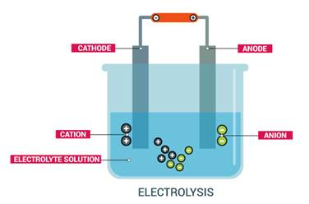
Cations and Anions
We talked about this is a previous lecture
cations “move to” the cathode
anions “move to” the anode
Cations are positively charged ions
Na⁺, K⁺, Ca²⁺, Li⁺
Anions are negatively
charged ions
Cl⁻, Br⁻, OH⁻
Cathode is negatively
charged pole
Anode is positively
charged pole

Slide 27
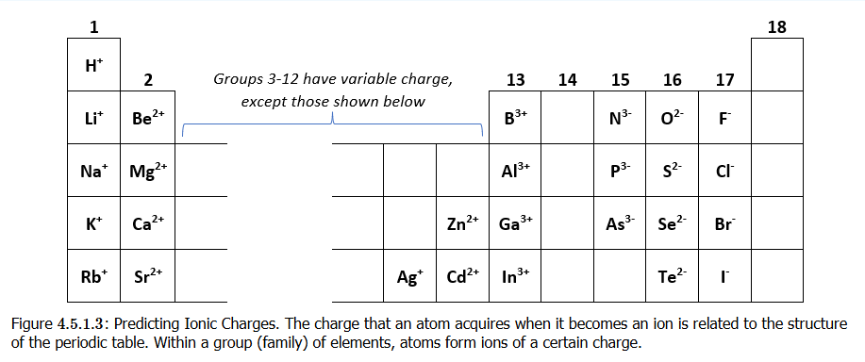
Predicting Cation or Anion
Table group and number of electrons in valence shell are connected: Group 1 – 1 valence electron, Group 2 – 2 valence electrons, and so on
This helps you predict whether an atom wants to get rid of acquire electrons!

Slide 28
Polyatomic Ions
In previous slides, we saw cations/anions as single elements
Here the anion is polyatomic. The method still applies. Note how parentheses are placed around the polyatomic (an)ion to treat it as an ionic group
calcium nitrate
What is cation and anion? | Ca²⁺, NO₃⁻
Exchange charge magnitudes to be subscripts on other atoms | Ca₁(NO₃)₂
Nothing to divide | Ca(NO₃)₂

Slide 29
Polyatomic Ions
potassium sulfate
In the calcium nitrate, we have TWO nitrates, so we had to use parentheses in final formula to show the group and add the subscript 2
If there is only 1 polyatomic ion group, we don’t need parentheses
What is cation and anion? | K⁺, SO₄²⁻
Exchange charge magnitudes to be subscripts on other atoms | K₂(SO₄)₁
Nothing to divide | K₂SO₄

Slide 30
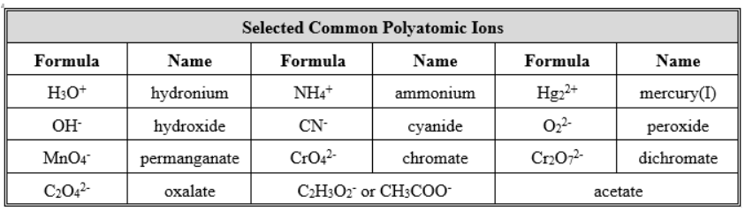
Polyatomic Ions
Ions not necessarily a charge on a single atom of an element
They can be a group of atoms bonded together that form natural (stable) ions

Slide 31
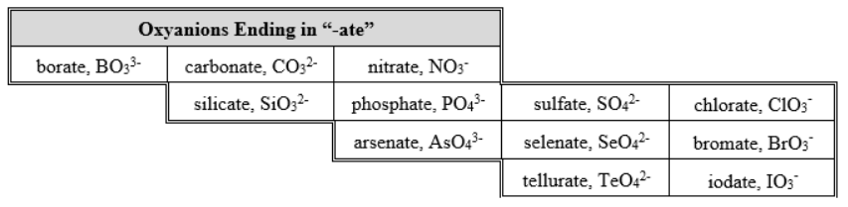
Polyatomic Ions

Slide 32
Polyatomic vs Molecular Ion
Extra stuff: no need to memorize
When atoms are bonded together, that looks like a molecule, right?
But chemists have a certain terminology here when it comes to polyatomic vs molecular ions
Methane (CH₄) is normally not an ionized molecule. But it can be if one uses high energy to knock an electron out. This is an unstable ion formation
In polyatomic ions, these are ionized as part of a stable state, and they remained ionized

Slide 33
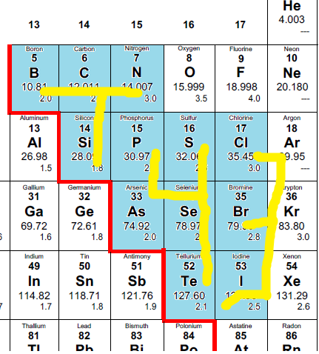
T43 Method
T: B, C, N, Si
4: P, S, As, Se, Te
3: Cl, Br, I
Number of oxygens:
4: PO₄, SO₄, AsO₄, SeO₄, TeO₄
3: ClO₃, BrO₃, IO₃
T: BO₃, CO₃, NO₃, SiO₃
Charge on the ions:
3-> (all -1): ClO₃⁻, BrO₃⁻, IO₃⁻
4-> (all -2): PO₄²⁻, SO₄²⁻, AsO₄²⁻, SeO₄²⁻, TeO₄²⁻
T: BO₃³⁻, CO₃²⁻, SiO₃²⁻, NO₃¹⁻
(start from N [1-], then C and Si [both 2-], then B [3-])

Slide 34











Testing Time: Compounds

Slide 35










Testing Time 2: Compounds

Slide 36
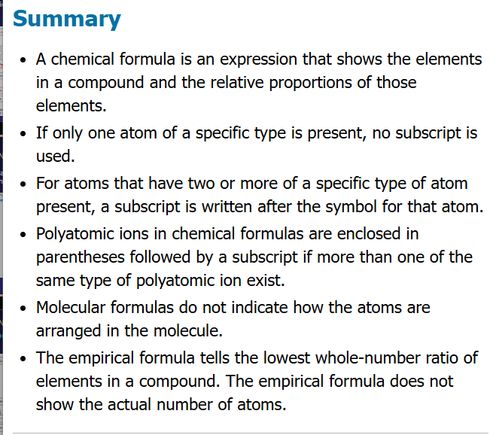
About Formulas

Slide 37
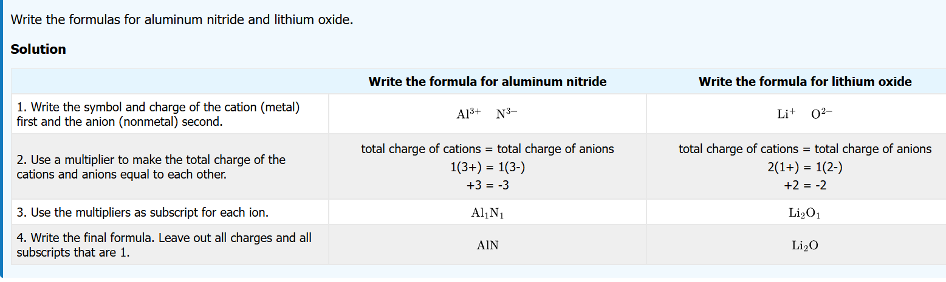
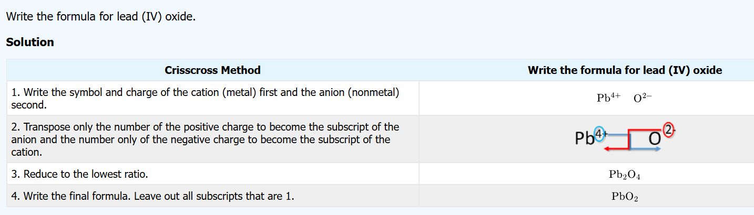
Writing Formulas

Slide 38
Criss-Cross Method
If you are trying to figure out number of atoms in a formula unit or molecule where the cations and anions have different charge magnitudes, this method helps
Formulas for ionic compounds regarded as empirical formulas: use lowest ratio
lead (IV) oxide
What is cation and anion? | Pb⁴⁺, O²⁻
Exchange charge magnitudes to be subscripts on other atoms | Pb₂O₄
Find “greatest common divisor” → 2 | PbO₂

Slide 39
Criss-Cross Method (more)
calcium oxide
copper(I) sulfide
What is cation and anion? | Ca²⁺, O²⁻
Exchange charge magnitudes to be subscripts on other atoms | Ca₂O₂
Find “greatest common divisor” → 2 | CaO
What is cation and anion? | Cu⁺, S²⁻
Exchange charge magnitudes to be subscripts on other atoms | Cu₂S₁
Nothing to divide | Cu₂S

Slide 40
Type I Cations: Only One Charge For Element
Ionic compounds
Type I cations: charge does not vary
directly use element name
Na⁺ ➔ “sodium”
Al³⁺ ➔ “aluminum”

Slide 41
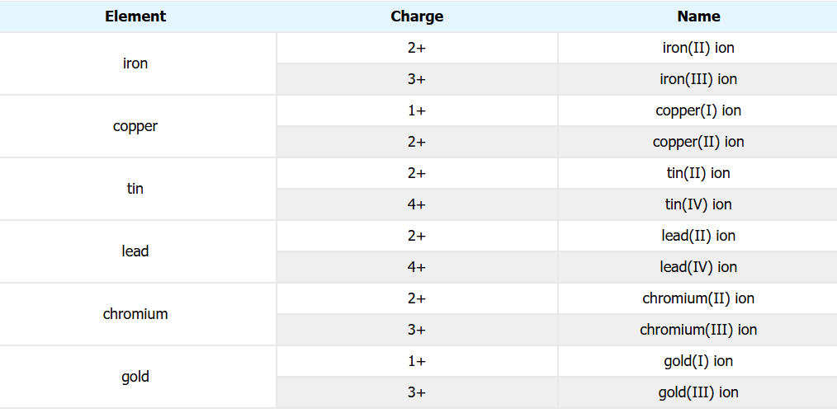
Type II Cations: Elements Can Have Many Charge States: Stock Naming
Ionic compounds
Type II cations: charge of element will vary
use the Stock system

Slide 42
Stock System
Part of the naming system for compounds
Formula | Old naming | Stock System | Ion
CuCl | cuprous chloride | copper(I) chloride | Cu⁺
CuCl₂ | cupric chloride | copper(II) chloride | Cu²⁺
FeCl₂ | ferrous chloride | iron(II) chloride | Fe²⁺
FeCl₃ | ferric chloride | iron(III) chloride | Fe³⁺

Slide 43
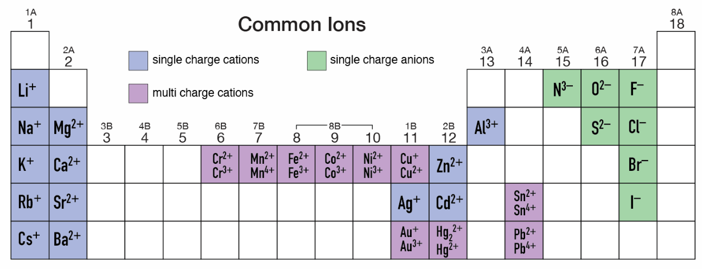
Charge States of Common Ions
The single charge cations are Type I cations and include Gallium in Group 13 (not shown) [Indium is not a Type I cation]
The Type II cations are numerous and include many more

Slide 44

Testing Time: Writing Formulas

Slide 45












Testing Time: Writing Formulas

Slide 46
Chemistry Nomenclature: Naming of Compounds
Some history
Lavoisier (1787) publishes
“New Chemical Nomenclature”
Now done by IUPAC
International Union of Pure and Applied Chemists
The Red Book
https://iupac.org/what-we-do/books/redbook/

Slide 47
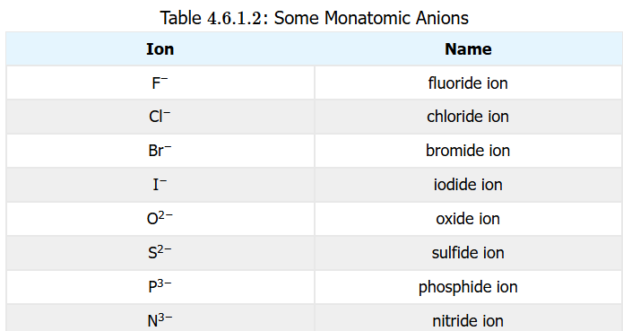
Naming of Compounds of Monatomic ANIONS
Ionic compounds
Monoatomic Anions: stem of element + -ide

Slide 48
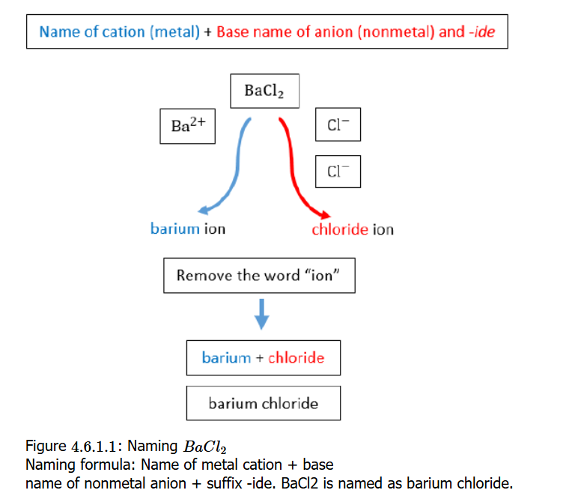
Chemistry Nomenclature: Naming of Compounds
Binary ionic compounds
Combine Type I monoatomic cation name with monoatomic anion with the –ide suffix

Slide 49
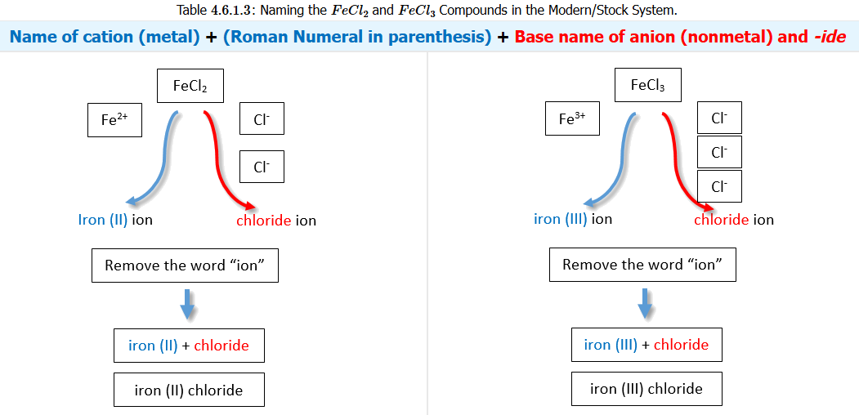
Chemistry Nomenclature: Naming of Compounds
Combine Type II cation name using Stock roman numerals with the anion name (-ide suffix)

Slide 50
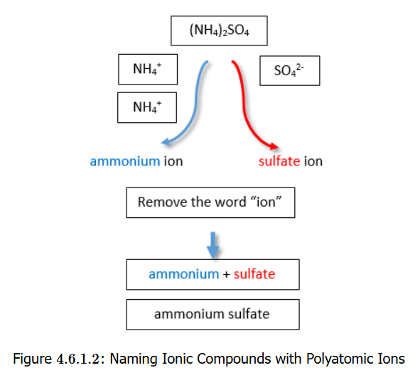
Chemistry Nomenclature: Naming of Compounds
Combine polyatomic cation names with polyatomic anion names

Slide 51

























Testing Time: Naming Ions/Compounds

Slide 52











Testing Time: Naming Ions/Compounds

Slide 53





















Testing Time: Naming Ions/Compounds

Slide 54
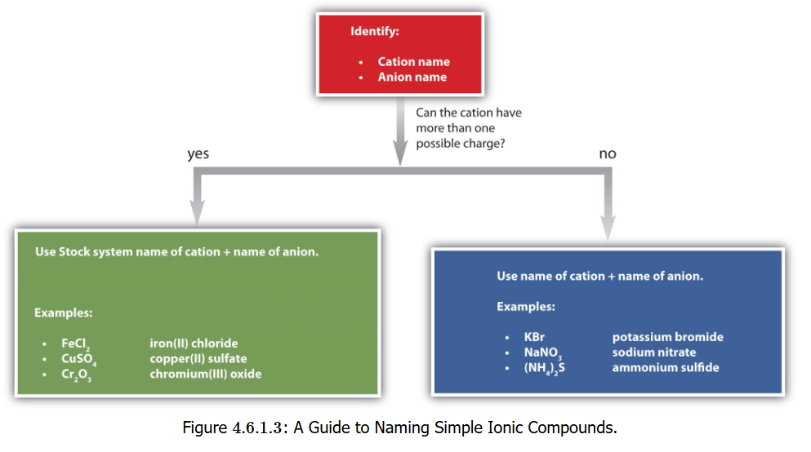
Chemistry Nomenclature:
Naming of IONIC Compounds
Flowchart

Slide 55
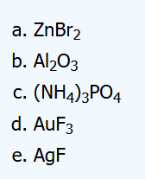
Chemistry Nomenclature: Naming of Compounds
Zn = zinc, Br = bromine → bromide
  Zn has only one ion (Zn²⁺)
  “zinc bromide”
Al = aluminum, O = oxygen → oxide
  Al has only one ion (Al³⁺)
  “aluminum oxide”
NH₄⁺ = ammonium, PO₄ = phosphate
  Only one charge state for each
  “ammonium phosphate” (not “triammonium phosphate”)
Au = gold, F = fluorine → fluoride
  Gold has multiple charge states
  “gold(III) fluoride”
Ag = silver, F = fluorine → fluoride
  Ag has only one ion (Ag⁺)
  “silver fluoride”

Slide 56
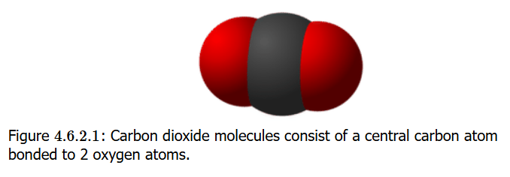
Molecular Compound Naming
Molecular compounds are inorganic compounds that take form of discrete molecules
  The bonds are shared between atoms (not ionic)
  Shared bonds are covalent bonds
  In carbon dioxide, the bond between the central carbon and two oxygen atoms on either side are shared (no “ionic character”)

Slide 57
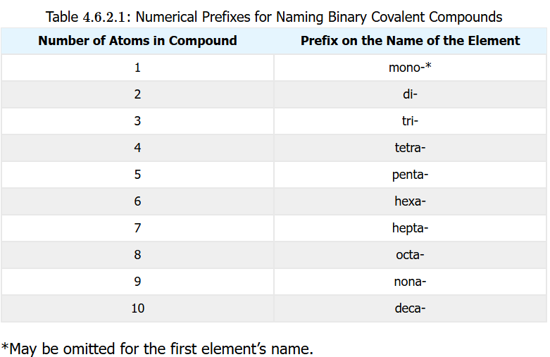
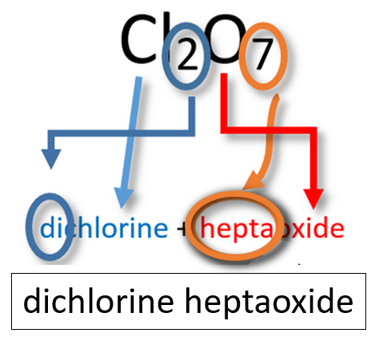
Molecular Compound Naming
Binary Molecular Compounds
1st element: name of element
2nd element: stem of element name + -ide
Prefixes: apply numerical prefixes to both elements

Slide 58






Molecular Compound Naming
Common Name Compounds
A systematic name not really used
H₂O: water | NH₃: ammonia
CH₄: methane | H₂O₂: hydrogen peroxide

Slide 59

Acid Naming: Binary Acids
All acids contain hydrogen: the H⁺ ion, which is just a proton!, is what makes (protic) acids acids.
Acids put in water release these H⁺ ions
Binary acid
Hydro- + base name of non-metal + -ic acid
Hydrochloric acid
(HCl)
Hydrofluoric acid
(HF)
Hydrobromic acid
(HBr)
Hydroiodic acid (HI)

Slide 60

Acid Naming: Oxyacids
An oxyacid consists of hydrogen, oxygen, and a 3rd element (typically non-metal)
If the polyatomic anion has an –ite ending
(SO₃²⁻ = sulfite), then the acid name will be
oxyanion base name + -ous acid
Thus H₂SO₃ → sulfurous acid

Slide 61

Acid Naming: Oxyacids
If the polyatomic anion has an –ate ending
(SO₄²⁻ = sulfate, PO₄³⁻ = phosphate), then the acid name will be:
oxyanion base name + -ic acid
Thus
H₂SO₄ → sulfuric acid
H₃PO₄ →
phosphoric acid

Slide 62


Naming Oxyanions
Without the H⁺ (H⁺ makes an acid an acid)

Slide 63


Naming Oxyacids

Slide 64


Slide 65

Formula Determination
The crisscross method that was used to determine the subscripts (indicating atom numbers) for compounds of metal cations and nonmetal ions can be used also to determine the formula for protic acids
You should know sulfate ion (SO₄²⁻) is a 2- anion. Knowing that, you can determine how many protons (H⁺ atoms) are needed to balance that charge of
the ion

Slide 66


Naming Tips/Mnemonics
https://youtu.be/ijSk_7ukv10

Slide 67

Tying It Together

